Slide 1

Currency Trading System
Group Member: Dawei He, Haoxiang Yin, Yufei Liu, Tao Yan
Notes:
today we have the pleasure of presenting our course project: currency trading system.

Slide 2
Overall Structure
PART 1
项目概况
算法
前端
Currency Trading System
Front End
PART 2
AWS Service
PART 3
Notes:
The presentation will be divided into three main sections: the overall architecture, the front-end, and the integration of AWS Services.

Slide 3
01
Overall Structure
PART
Notes:
Let's begin with the foundation of our project - the overall architecture.

Slide 4

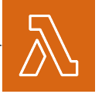











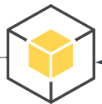

Architecture
AWS Lambda
Overall Architecture
DynamoDB
Forecast
S3 Bucket
Currency Trading System
API Gateway
EC2
Data
Suggestion
Prediction
Trading
Amazon Lex
RDS
SES
Build Container
EventBridge
Training Pipeline
CloudWatch

Slide 5
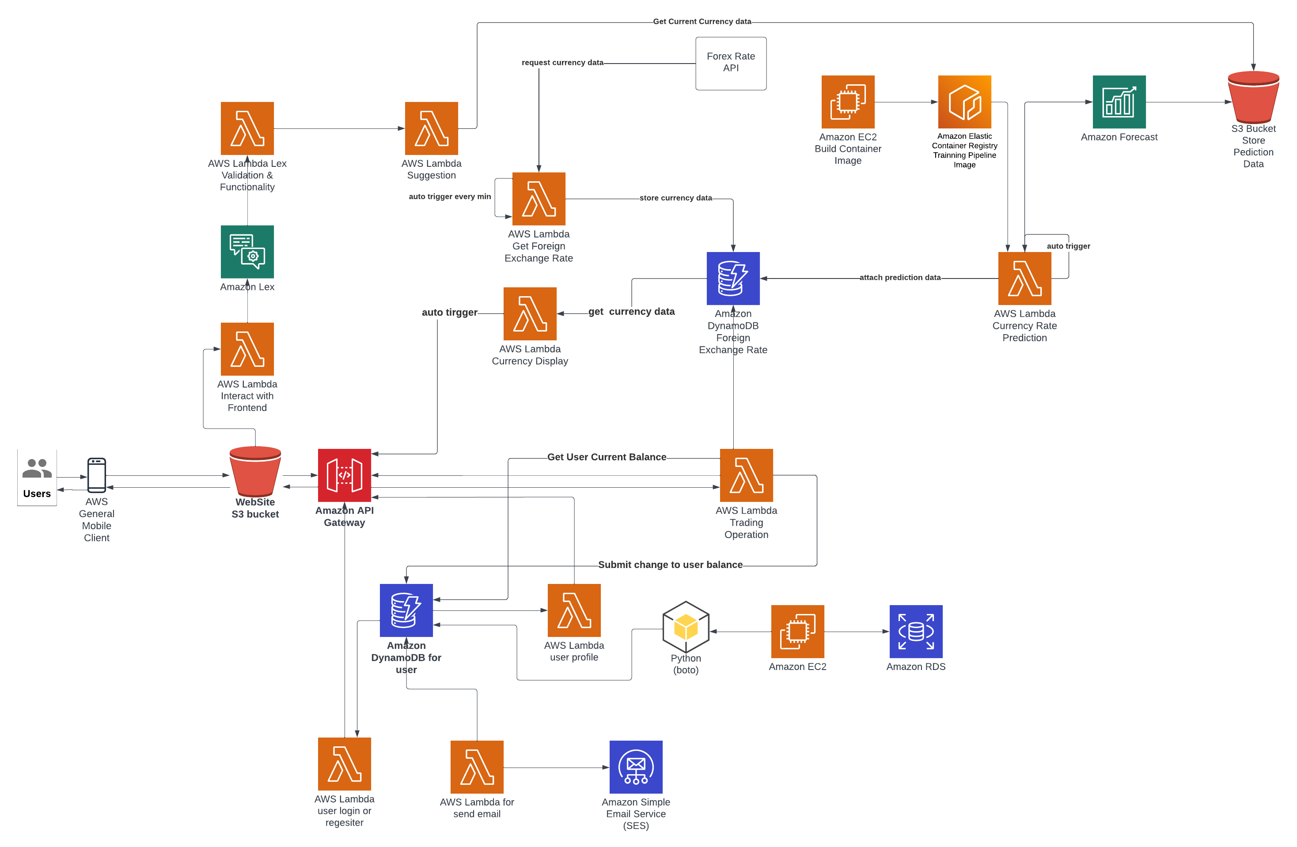
Architecture
AWS Lambda
DynamoDB
Forecast
S3 Bucket
API Gateway
EC2
Amazon Lex
RDS
SES
Build Container
EventBridge
Training Pipeline
CloudWatch

Slide 6
Architecture
AWS Lambda
DynamoDB
Forecast
Data
Prediction
S3 Bucket
Suggestion
API Gateway
EC2
Amazon Lex
RDS
SES
Trading
Build Container
EventBridge
Training Pipeline
CloudWatch

Slide 7
Architecture
AWS Lambda
DynamoDB
Forecast
S3 Bucket
Scalable
Real-time
API Gateway
EC2
Amazon Lex
High Availability
High Reliability
RDS
SES
Build Container
EventBridge
Training Pipeline
CloudWatch

Slide 8
02
PART
Front End

Slide 9
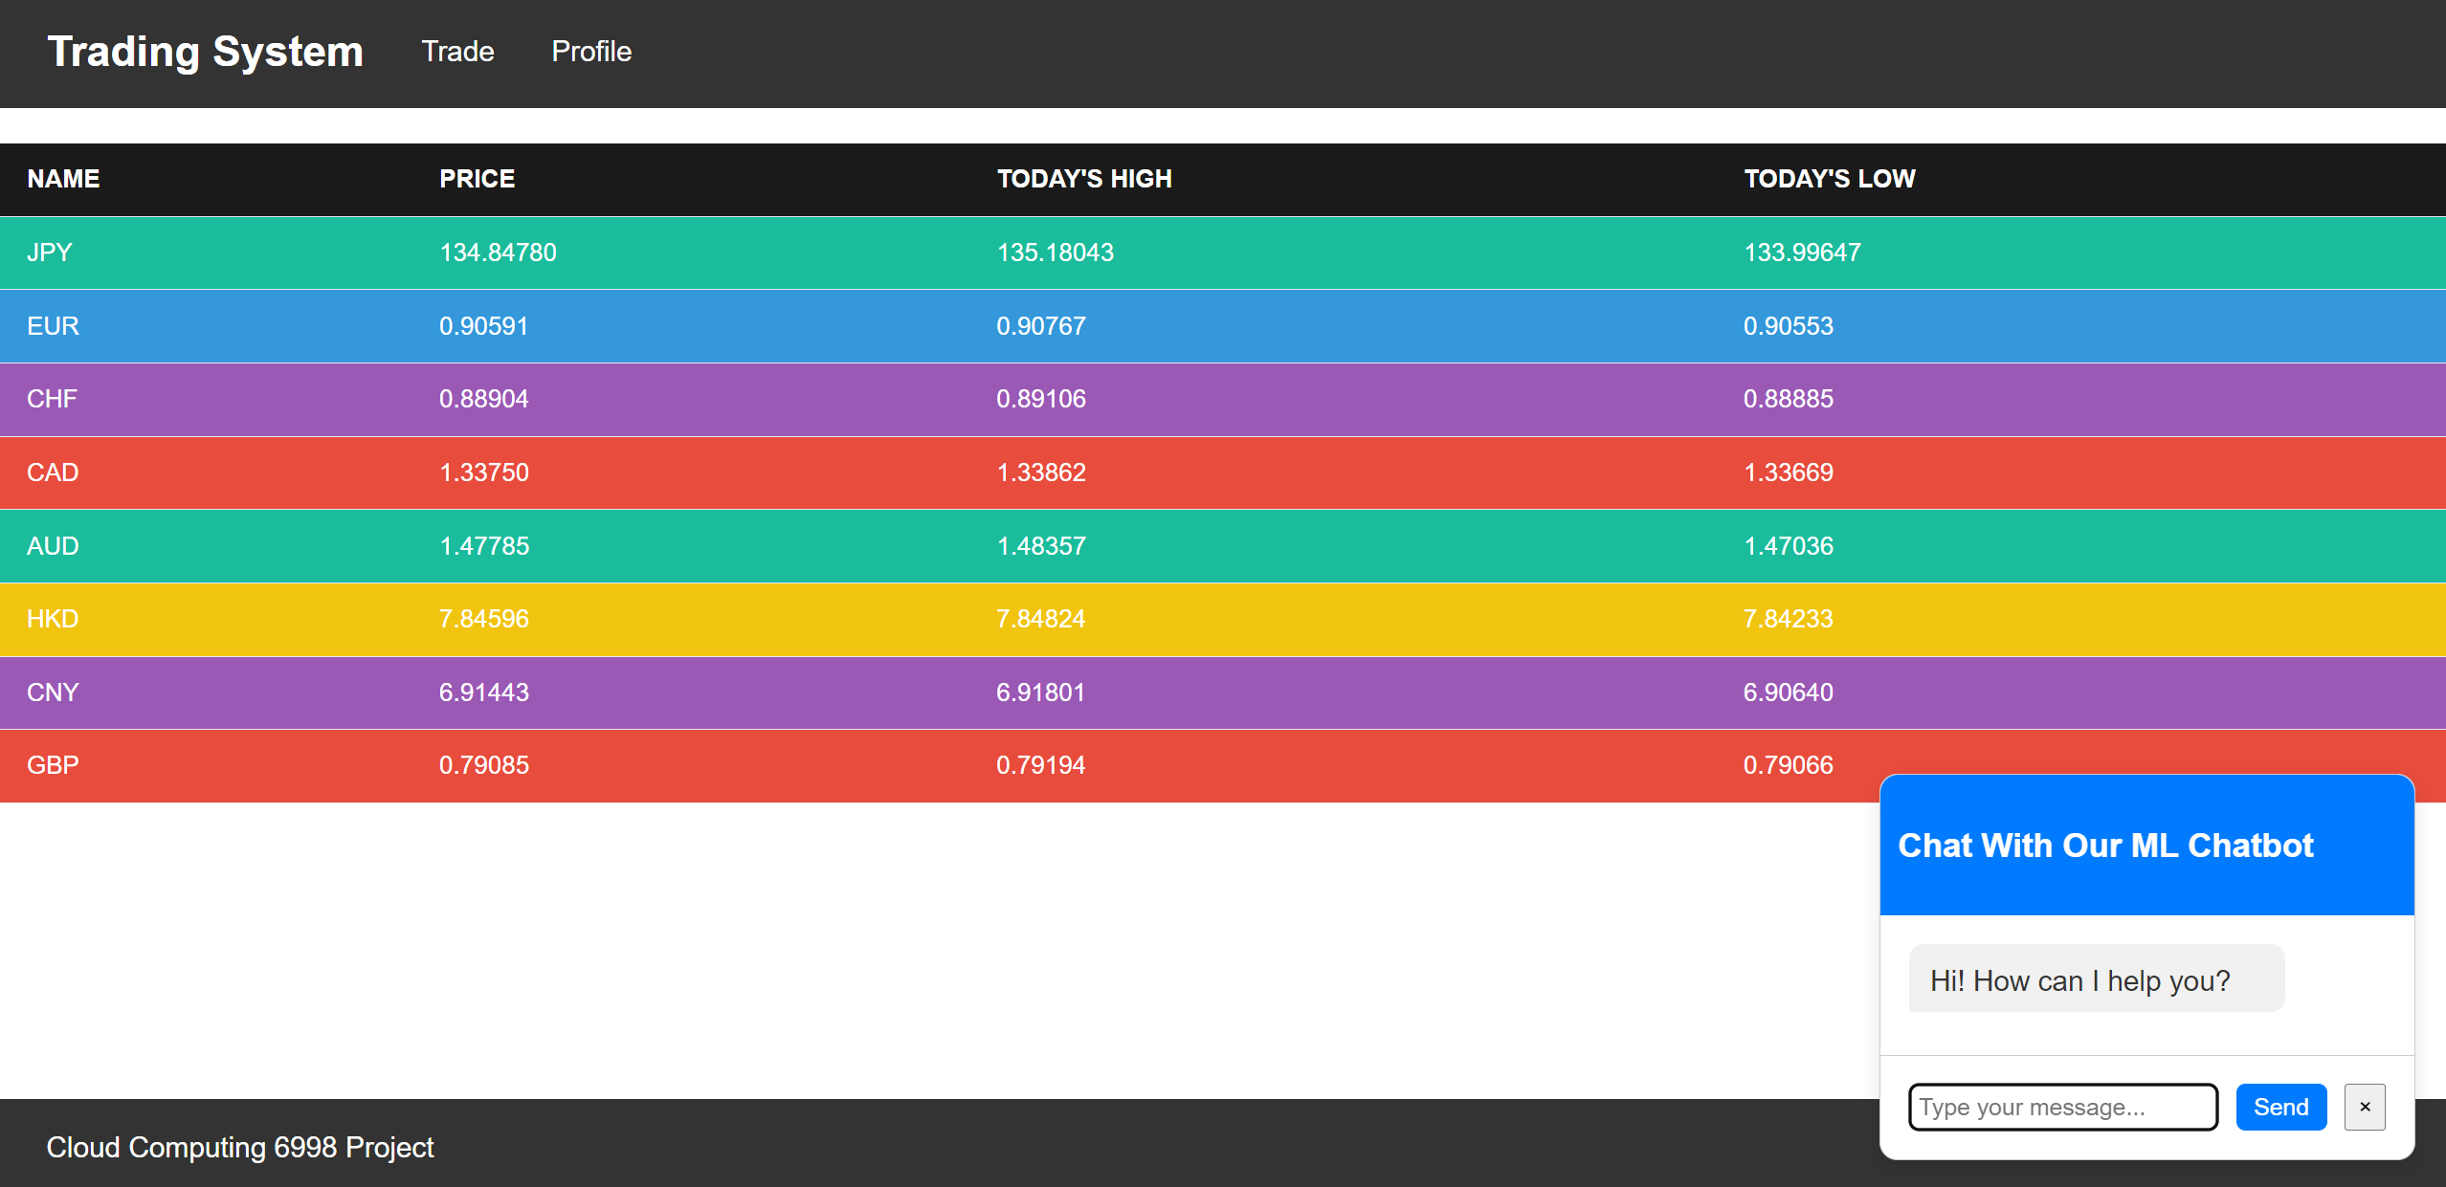
Front End

Slide 10
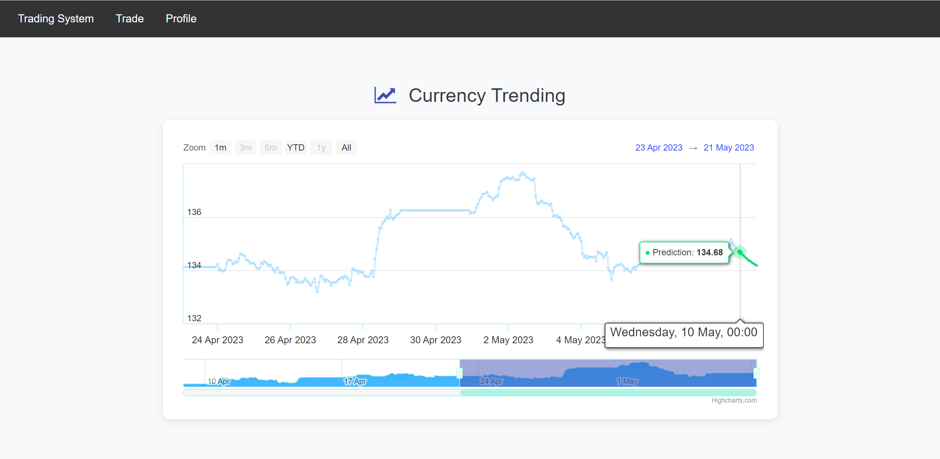
Front End

Slide 11
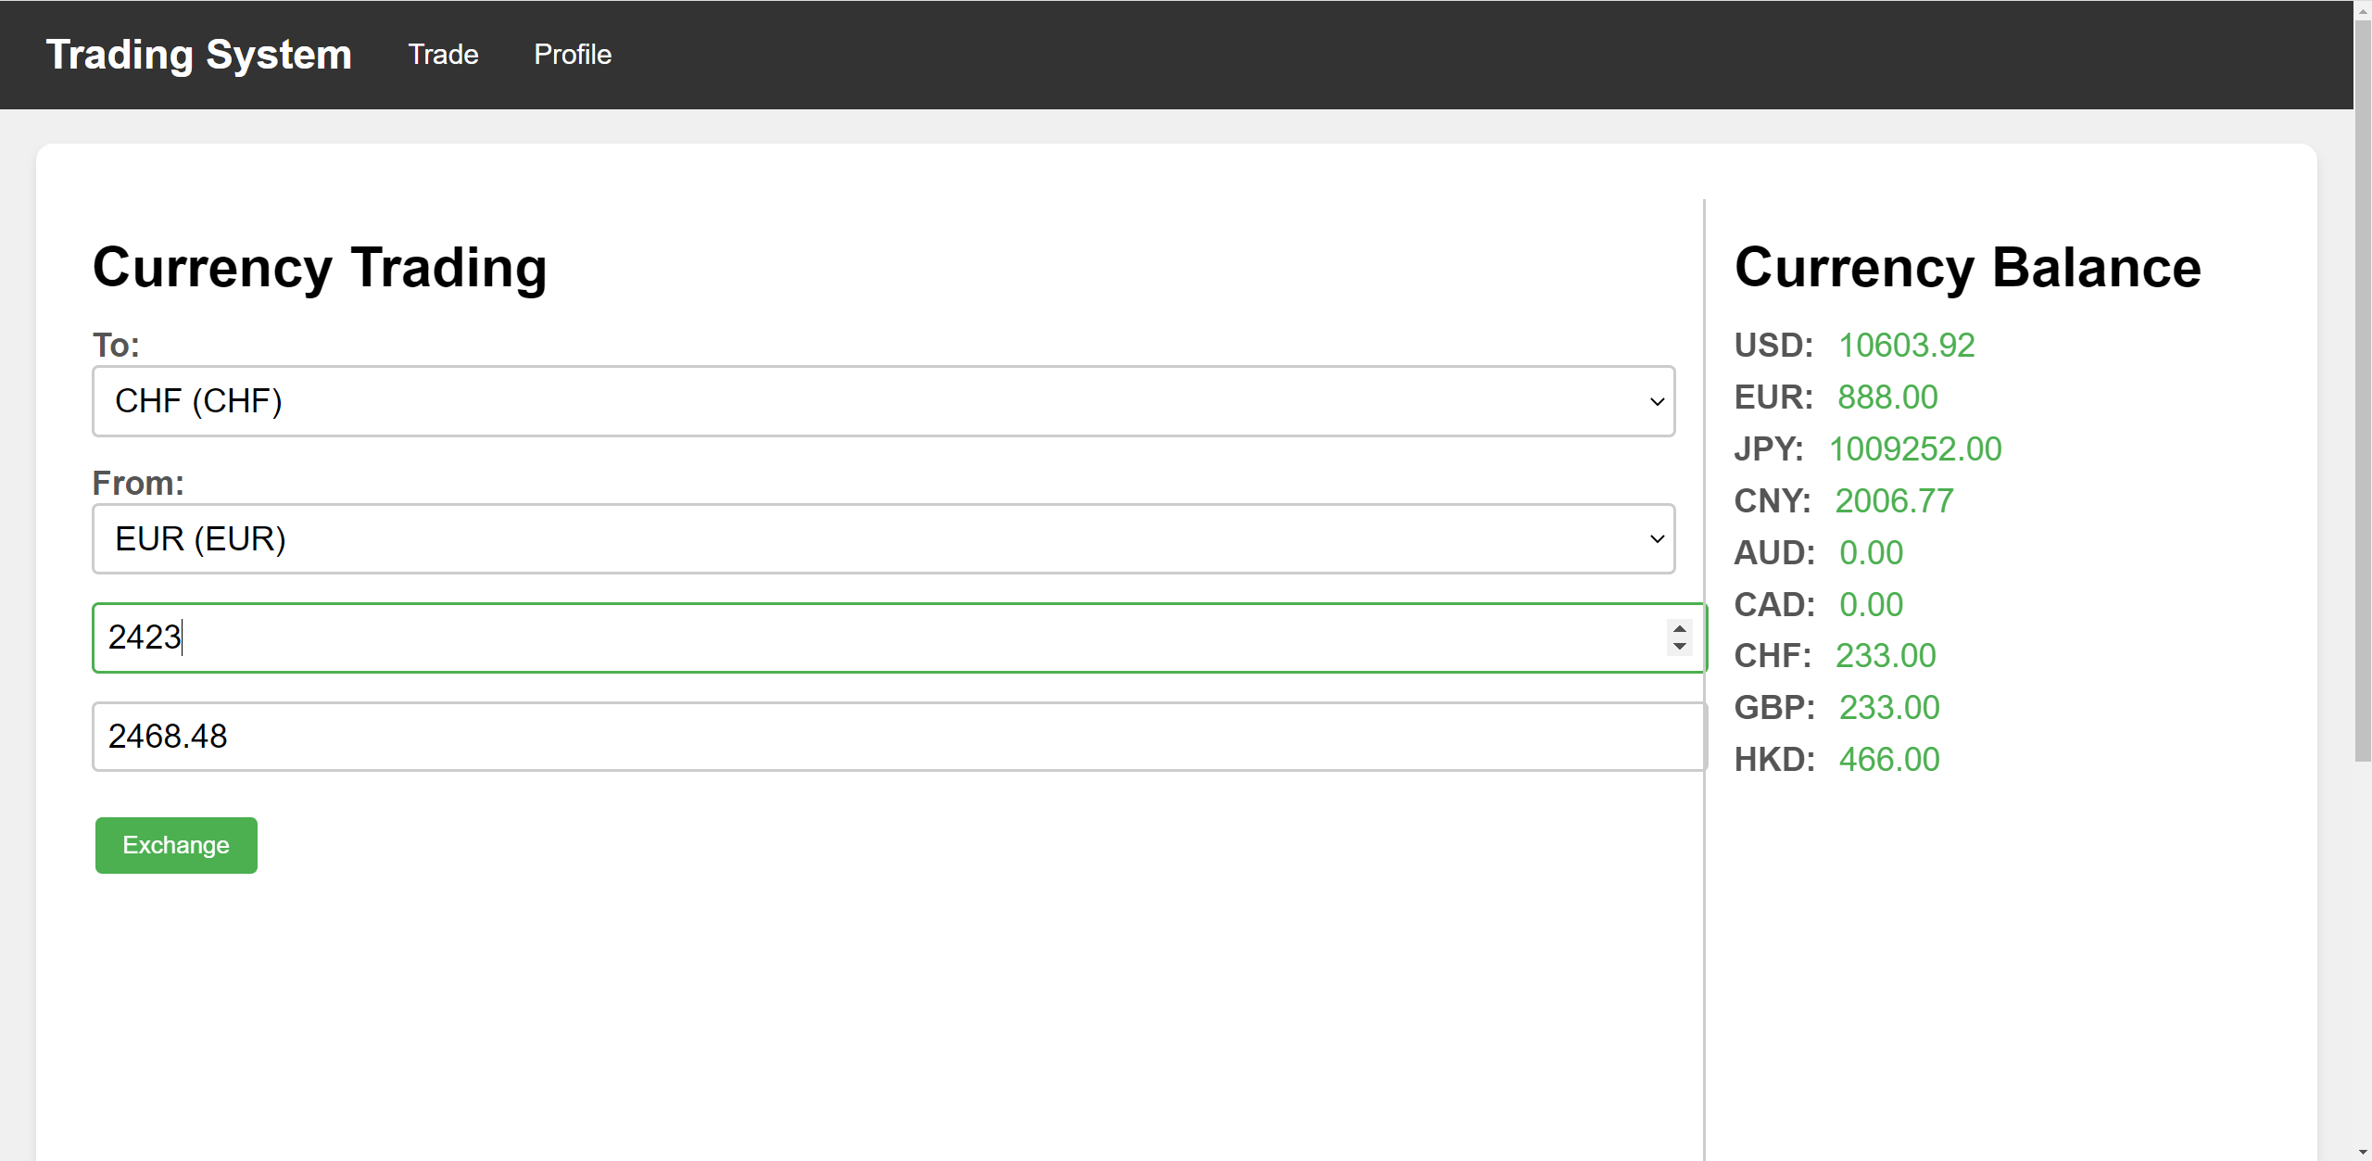
Front End

Slide 12
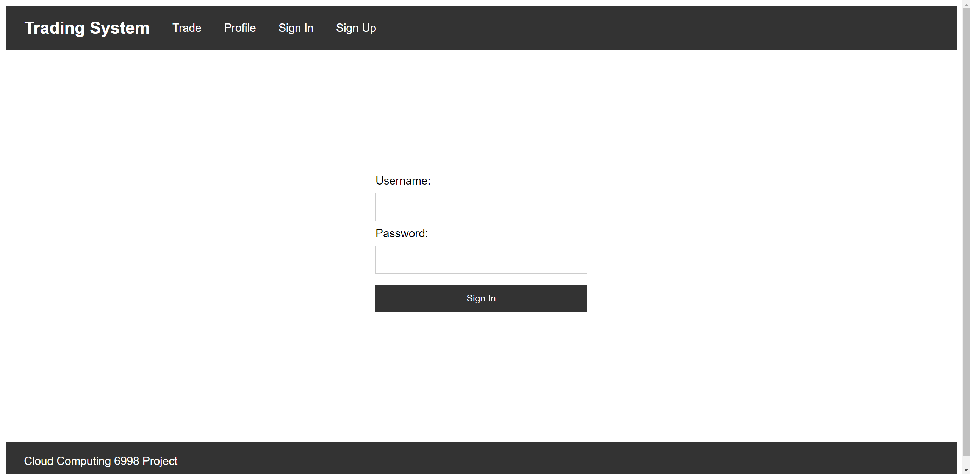
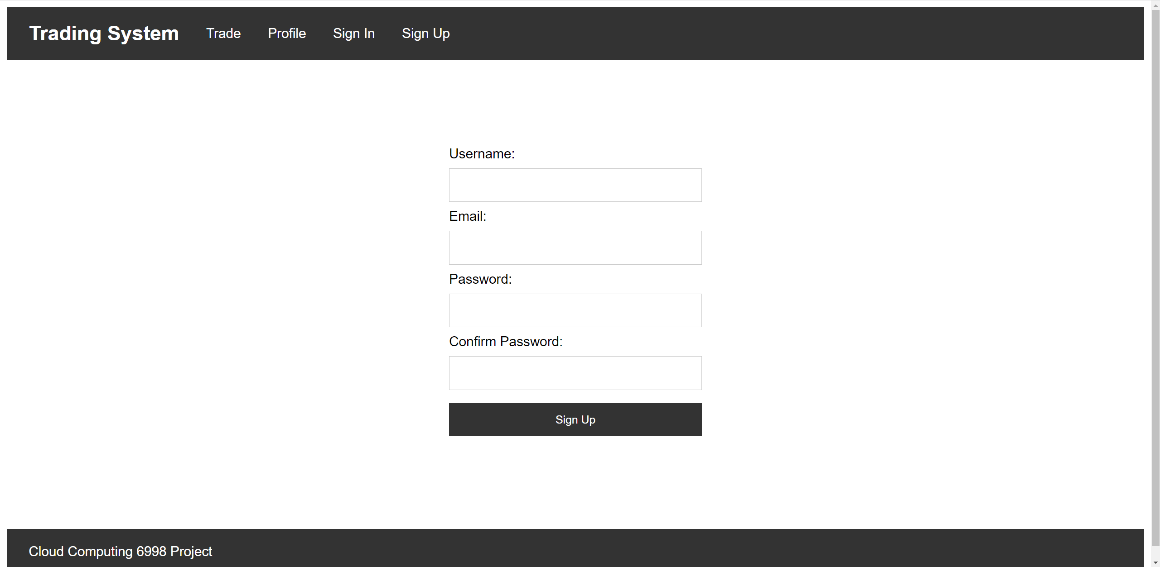
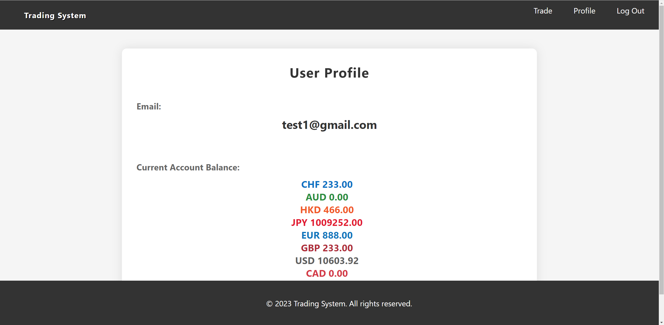
Front End

Slide 13
03
PART
AWS Services

Slide 14
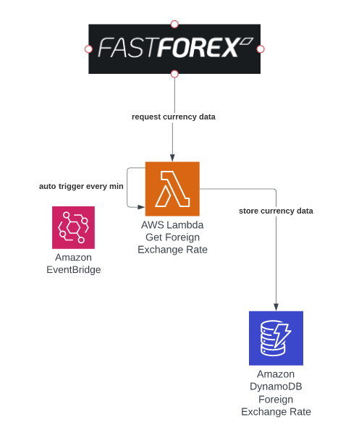
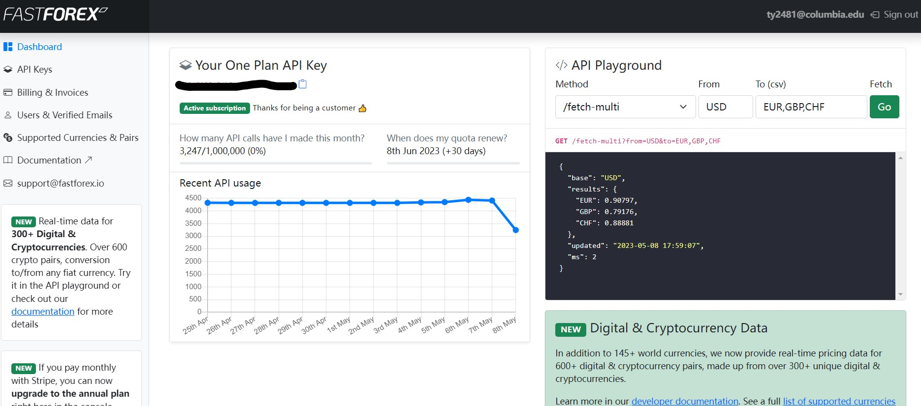
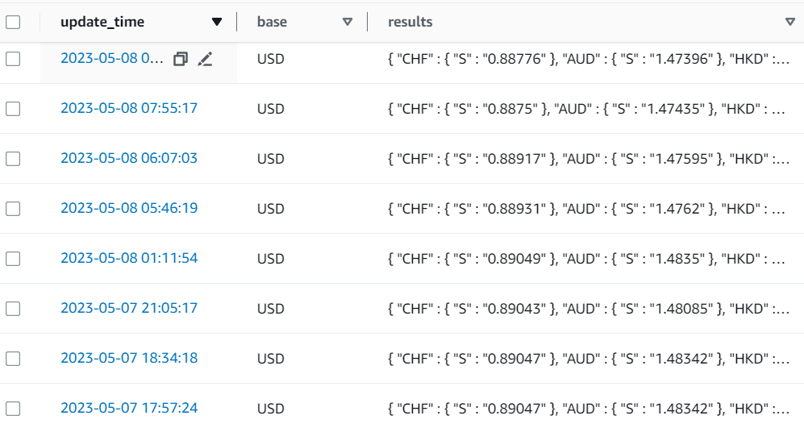
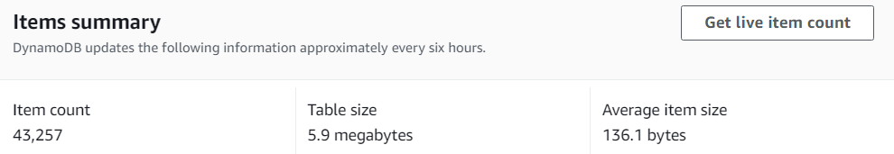
Fetch real-time forex data

Slide 15
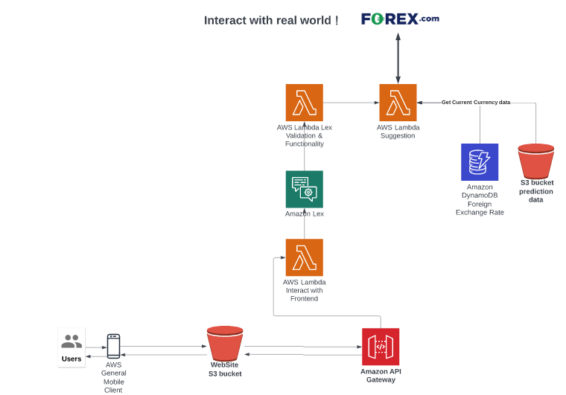
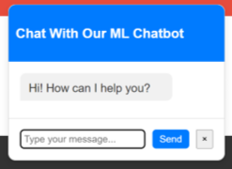
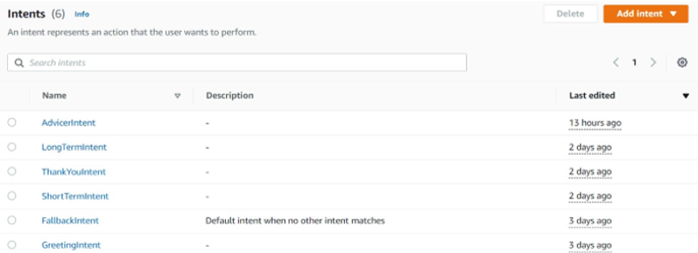
Provide investment suggestions

Slide 16
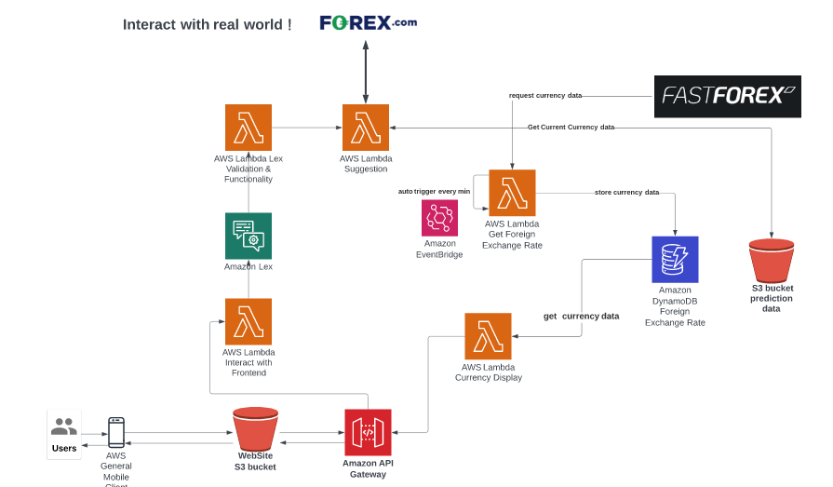
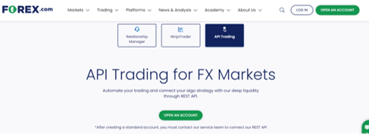
Offer virtual trading and real trading

Slide 17
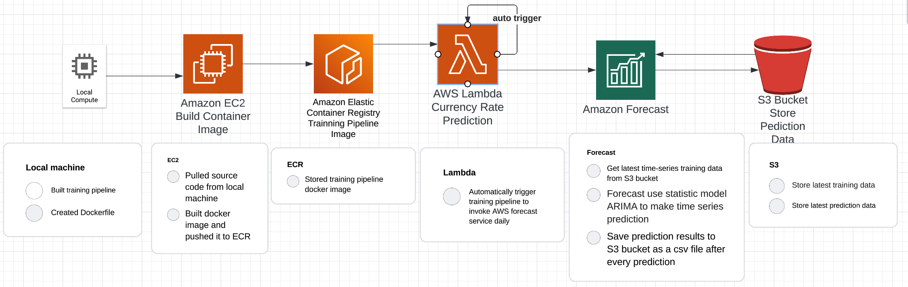
Prediction

Slide 18
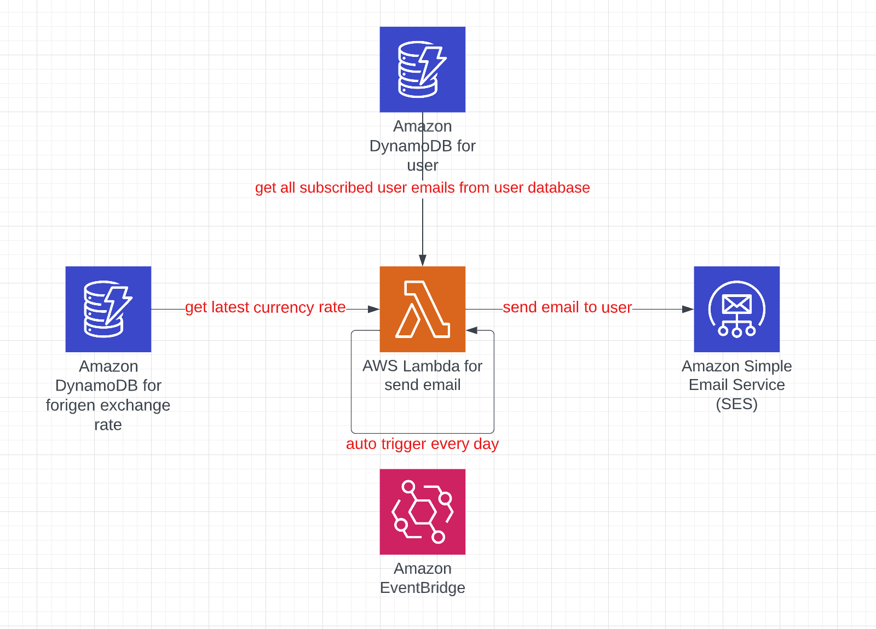
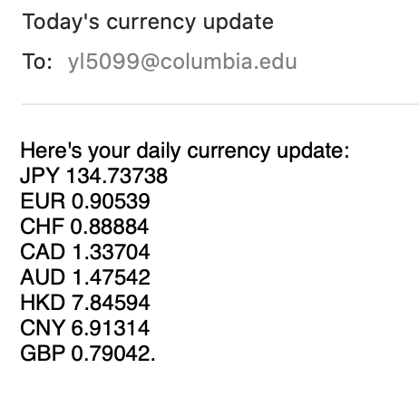
SES Service
Email example:

Slide 19

User Data Backup
Periodically Update
Update
Update
Trigger
Trigger
Read
Lambda
DynamoDB
Boto3
EC2
RDS
Other Components
User Data
Backup

Slide 20
Q&A
Data Microservice
Suggestion
Microservice
Prediction
Microservice
Trading
Microservice

